Slide 1
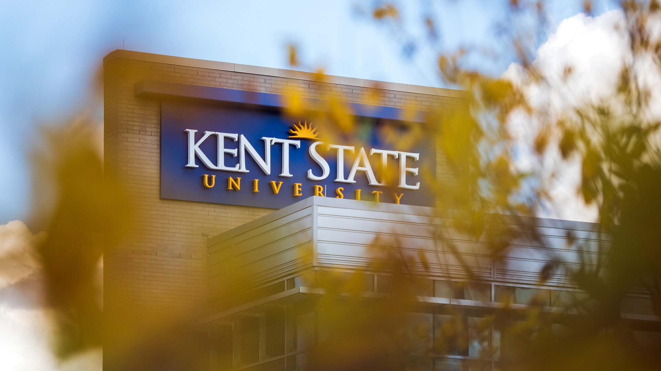
SHOW UP -Student Attendance Dashboard
Presented by Team Δ (Delta)
Ganasai Palakurthi
Mani Surya Teja Kota
Akshaya Sunkireddy
Venkatesh Singamsetty
Chandra Vamsi Mummana
Shashank Uppalamurthy
Notes:
Good afternoon, everyone. We are Team Delta, On behalf of my team, I’d like to thank you for being here today. My name is Ganasai Palakurthi, and we’re excited to present our project, SHOW UP - Student Attendance Dashboard. As a team, we came together with the shared vision of addressing a common but crucial challenge in academics: attendance tracking.
Our solution aims to simplify the process, ensuring it's efficient, accurate, and beneficial for both students and professors. Today, we’ll walk you through the key features, our design approach, and how we plan to make SHOW UP an essential tool for academic success.
I’ll begin by sharing overview
From there, my team will dive deeper into the methodology, features, development process, and the impact we believe SHOW UP can make. Let’s begin

Slide 2
Problems with Traditional Approach to Taking Attendance
Manual Tracking
Inaccurate
Time-Consuming
Notes:
Before we dive into our solution, let’s take a step back and consider the challenges many of us have faced with traditional attendance tracking methods. Whether you’re a professor managing a packed lecture hall or a student ensuring your attendance is recorded accurately, these problems are all too familiar.
Manual Tracking: Most professors still rely on manually marking attendance, which is prone to human error, can cause delays, and ultimately creates inefficiencies in managing records.
Inaccurate Records: Whether it’s paper-based systems or basic digital logs, these methods often lack reliability. Issues like proxy attendance or missed entries make them far from foolproof.
Time-Consuming: Finally, traditional methods can take up valuable class time—especially in large lecture halls where the process becomes cumbersome and detracts from teaching and learning.
These challenges not only impact the classroom experience but also highlight the need for a smarter, more efficient solution. That’s where SHOW UP comes in

Slide 3
How We Are Solving the Problems
Voice-Based Verification
Automated and Real-Time
Improved Accuracy
METHODOLOGY
Notes:
Now, let’s move on to one of the standout features of our solution: Voice-Based Verification.
We’ve designed this feature to tackle common attendance challenges like proxy entries and inefficiency. Here’s how it works and why it’s a game-changer:
Voice Recognition Technology: By leveraging voice recognition, we ensure that only the correct student can mark their attendance, significantly reducing the chances of proxy attendance.
Automated and Real-Time: Attendance is verified automatically and instantly, saving valuable time for both students and professors.
Improved Accuracy: Students record unique voice cue, which is matched against the professor’s input, ensuring only verified entries are accepted.
With these benefits, we’re not just solving a problem—we’re enhancing the experience of attendance tracking for everyone involved.

Slide 4
How We Are Solving the Problems
02
01
03
METHODOLOGY
Voice-Based Verification
Automated and Real-Time
Improved Accuracy
The Recordings Should Match
Students and the Professor Record Their Inputs in the Application
Voice Input by Professor

Slide 5

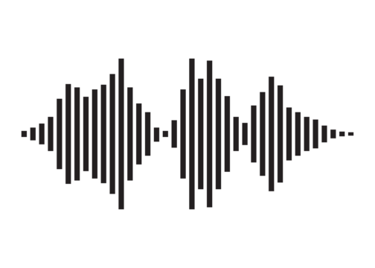



Voice Recognition for Attendance: What Could Go Wrong?
METHODOLOGY
03
02
The Recordings Should Match
Students and the Professor Record Their Inputs in the Application
01
Voice Input by Professor
PROFESSOR’S DESK
Notes:
The application compares each student’s recorded input with the professor’s original recording, analyzing for both accuracy and timing.
Successful Match: If the student’s recording aligns with the professor’s cue, the attendance is marked as successful.
Mismatch or Absence: If there is no recording or the recording does not match, the system flags the student’s attendance as incomplete, prompting follow-up actions which can be to contact the professor regarding any kind of discrepancies.

Slide 6

METHODOLOGY
RECORDING ON THE
PROFESSOR SIDE
PROFESSOR’S DESK
Voice Input by Professor
RECORDING ON THE
STUDENTS SIDE
The Recordings Should Match
03
Students might record the professor’s voice and share it with their peers to falsely mark attendance.
02
Students and the Professor Record Their Inputs in the Application
01
Notes:
So, what could possibly go wrong if we rely on voice recognition for attendance

Slide 7

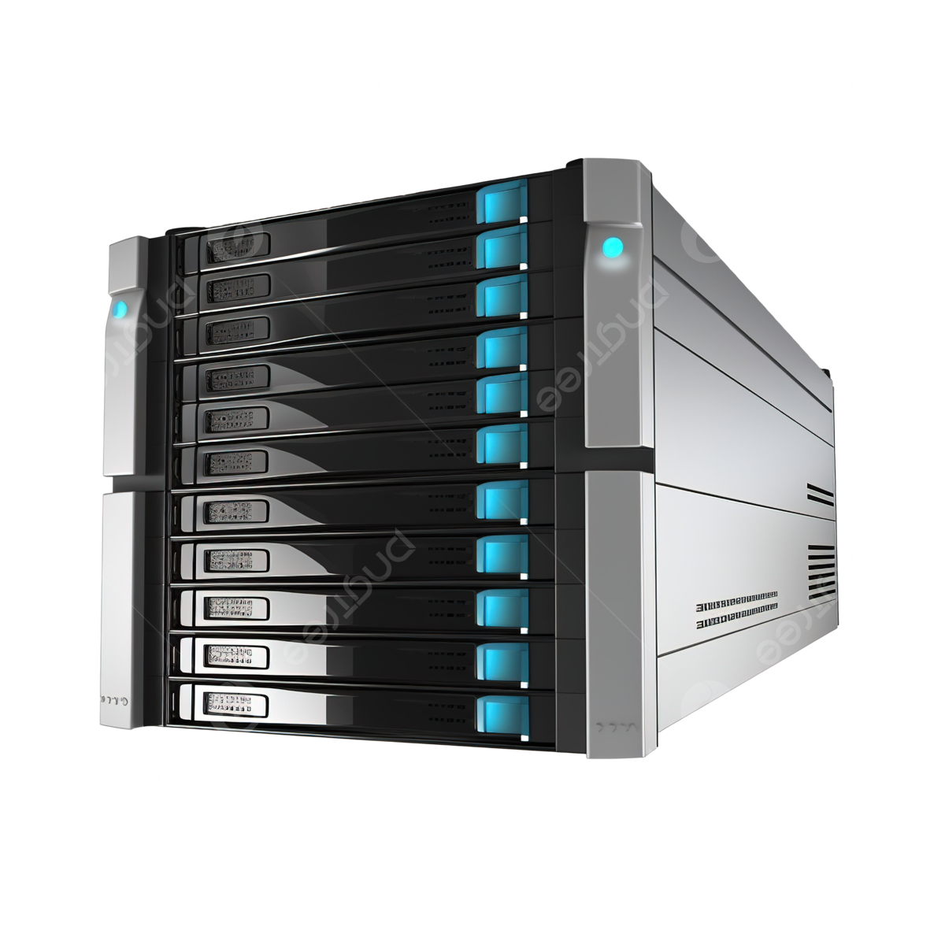

RECORDING ON THE
PROFESSOR SIDE
PROFESSOR’S DESK
Professor Table
RECORDING ON THE
STUDENTS SIDE
Students might record the professor’s voice and share it with their peers to falsely mark attendance.
Notes:
So, what could possibly go wrong if we rely on voice recognition for attendance

Slide 8
Professor Table
Students might record the professor’s voice and share it with their peers to falsely mark attendance.
Notes:
So, what could possibly go wrong if we rely on voice recognition for attendance

Slide 9


Professor Table
Present
Mismatch in
Recordings
No Recording
Students might record the professor’s voice and share it with their peers to falsely mark attendance.
Notes:
So, what could possibly go wrong if we rely on voice recognition for attendance

Slide 10
Student Table
Present
Student ID | Student Name | Attendance
Mismatch in
Recordings
No Recording
Students might record the professor’s voice and share it with their peers to falsely mark attendance.
Notes:
So, what could possibly go wrong if we rely on voice recognition for attendance

Slide 11
Voice Recognition for Attendance: What Could Go Wrong?
Student Table
Present
Student ID | Student Name | Attendance
811327889 | Michael Johnson | Present
811327890 | Olivia Carter | Discrepancy
811327891 | Ethan Davis | Present
811327892 | Emily Thompson | -
Mismatch in
Recordings
No Recording
Students might record the professor’s voice and share it with their peers to falsely mark attendance.
Notes:
So, what could possibly go wrong if we rely on voice recognition for attendance

Slide 12
Voice Recognition for Attendance: What Could Go Wrong?
Student Table
Student ID | Student Name | Attendance
811327889 | Michael Johnson | Present
811327890 | Olivia Carter | Discrepancy
811327891 | Ethan Davis | Present
811327892 | Emily Thompson | Absent
Students might record the professor’s voice and share it with their peers to falsely mark attendance.
Notes:
So, what could possibly go wrong if we rely on voice recognition for attendance

Slide 13
Voice Recognition for Attendance: What Could Go Wrong?
Students might record the professor’s voice and share it with their peers to falsely mark attendance.
How We Prevented It : Effective Mitigation Strategies
Notes:
A key challenge with voice-based attendance systems is the potential for students to record the professor's voice and share the recording with others. This could allow peers to fraudulently mark their attendance without being present in class, undermining the integrity of the system.

Slide 14
Students might record the professor’s voice and share it with their peers to falsely mark attendance.
How We Prevented It : Effective Mitigation Strategies
Randomized Phrases for Security
Timestamp Analysis
Algorithmic Detection of Audio Patterns

Slide 15
Targeted Users
How We Prevented It : Effective Mitigation Strategies
Randomized Phrases for Security
Timestamp Analysis
Algorithmic Detection of Audio Patterns
Targeted Users
Notes:
Addressing bypass concerns in a voice recognition-based attendance system is essential, especially to prevent unauthorized attendance marking. Here are effective mitigation strategies for handling this:
1. Randomized Phrases for Security
- Dynamic Phrase Prompts: Instead of using a single fixed phrase, prompt the professor with randomized phrases each time they log attendance. This prevents students from using pre-recorded audio clips, as each attendance session would require a different phrase.
2. Timestamp Analysis
- Real-Time Timestamping: Mark the precise time when each attendance recording is made and cross-check it with class start times. Any attempts to use pre-recorded audio at different times can be flagged.
3. Algorithmic Detection of Audio Patterns
- Audio Playback Detection Algorithms: We developed algorithms that can distinguish between live voices and recordings. Recorded audio often lacks the nuanced sound frequencies and resonance of live speech, which our algorithm can detect.
- Playback Speed and Noise Pattern Analysis: Analyze background noise and playback speed. Pre-recorded audio may show signs of uniformity or subtle inconsistencies in sound patterns, whereas live audio typically has slight fluctuations.
These measures will enhance the robustness of the voice-based attendance system, significantly reducing the likelihood of bypass through recorded audio.

Slide 16
Randomized Phrases for Security
Timestamp Analysis
Algorithmic Detection of Audio Patterns
Targeted Users
Professor
Student

Slide 17
Targeted Users
Voice Input for Attendance
Professor
Student
Notes:
Students: Users who will record their attendance using voice inputs and track their attendance history, feedback, and analytics.
Professors: Users who will manage attendance, generate reports, override corrections, and analyze class attendance patterns

Slide 18
Professors
Professor Dashboard Features
Voice Input for Attendance
Professor
Student
Manual Overrides and Corrections
Manual Overrides and Corrections
Notes:
Professors can initiate attendance by recording a unique voice input, ensuring secure and real-time verification for students in class.

Slide 19
Voice Input for Attendance
Professor Dashboard Features
Voice Input for Attendance
Manual Overrides and Corrections
Attendance Analytics
Generate Attendance Reports of students
Notes:
Enables professors to manually adjust attendance records to account for any discrepancies, absences, or special cases that require correction.

Slide 20
Student Dashboard Features
Professor Dashboard Features
Manual Overrides and Corrections
Attendance Analytics
Notifications
Voice Input for Attendance
Notes:
Allows professors to create detailed attendance reports for individual students or entire classes, making it easy to review and share attendance data as needed.
Provides a live view of attendance status, with immediate updates on which students have marked their attendance, ensuring seamless tracking during class sessions.
Offers insights into overall attendance trends, identifying patterns such as frequent absences or attendance rates over time, to support informed decision-making.

Slide 21
Student Dashboard Features
Professor Dashboard Features
Voice Input for Attendance
Attendance Analytics
Notifications
Manual Overrides and Corrections
Voice Input for Attendance

Slide 22
Student Dashboard Features
Professor Dashboard Features
Voice Input for Attendance
Manual Overrides and Corrections
Attendance Analytics
Notifications
Voice Input for Attendance

Slide 23
Attendance Analytics
Professor Dashboard Features
Student Dashboard Features
Attendance Feedback
Voice Input for Attendance
Dashboard Analytics
Attendance Analytics
Attendance Feedback
Manual Overrides and Corrections
Notes:
Students can easily submit their attendance by recording the professor’s cue directly within the application.

Slide 24
Student Dashboard Features
Dashboard Analytics
Voice Input for Attendance
Notify Professor
Notes:
A complete record of past attendance submissions, allowing students to view dates, times, and the status of each attendance attempt.
Visual summaries of attendance trends, including attendance percentage, recent activity, and days missed, providing insights into attendance patterns.

Slide 25
Student Dashboard Features
Notify Professor
Dashboard Analytics
Voice Input for Attendance

Slide 26
Student Dashboard Features
Dashboard Analytics
UI Screenshots
Voice Input for Attendance
Notify Professor

Slide 27
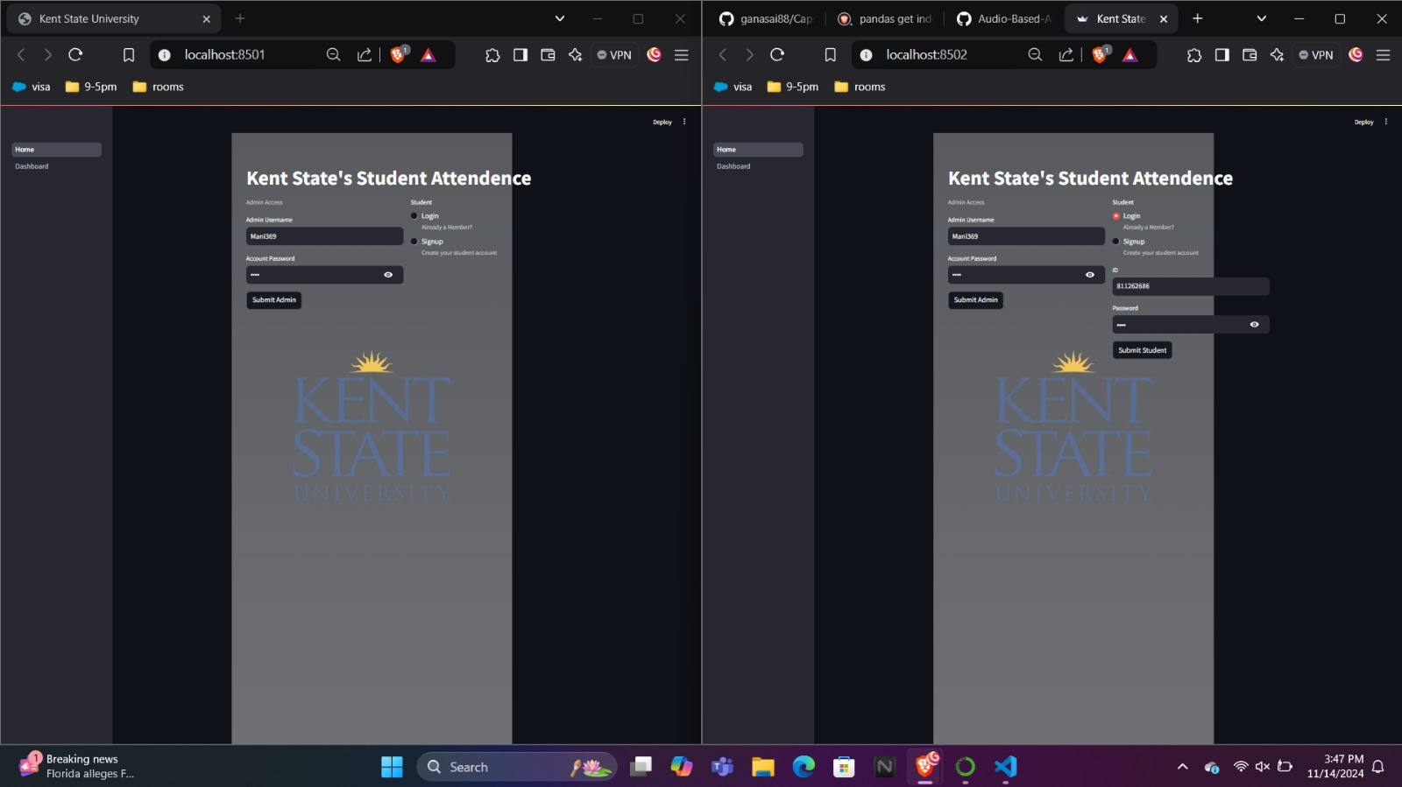
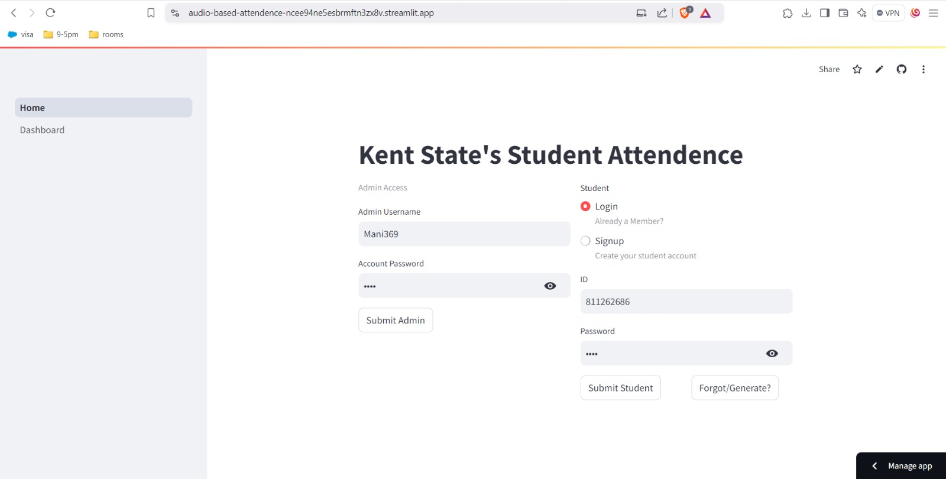
Voice Input for Attendance
Student Dashboard Features
UI Screenshots
Dashboard Analytics
Notify Professor
Attendance Feedback
Push Notifications & Alerts

Slide 28
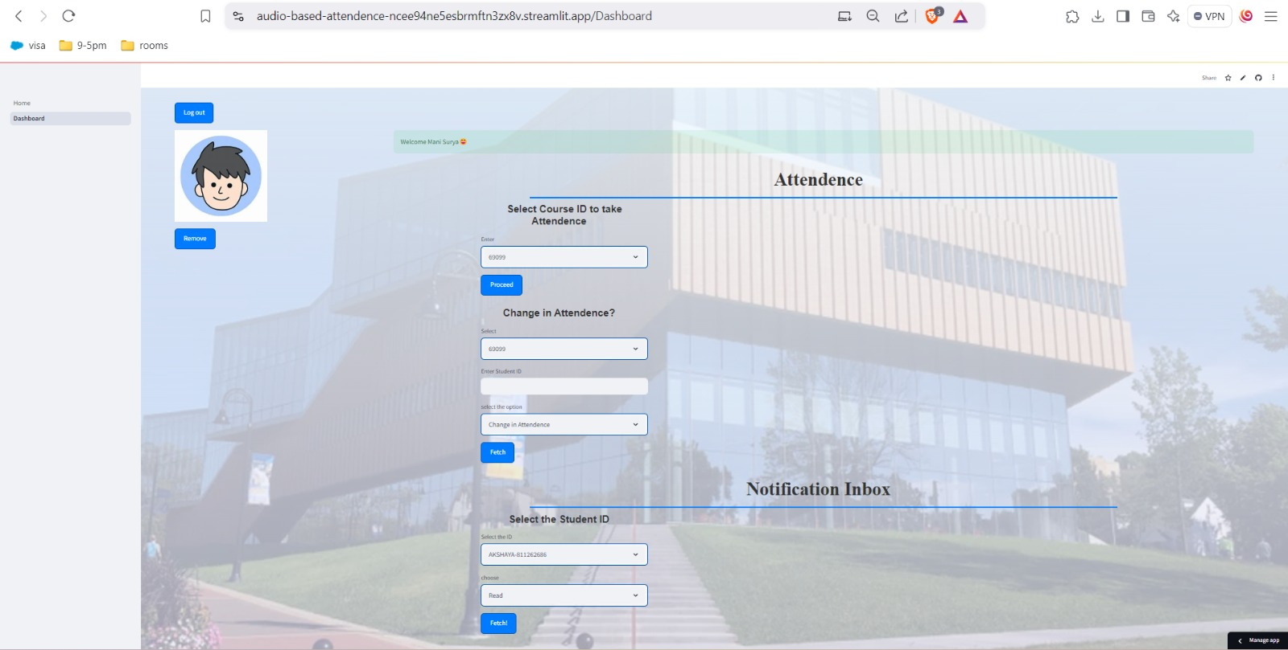
UI Screenshots

Slide 29
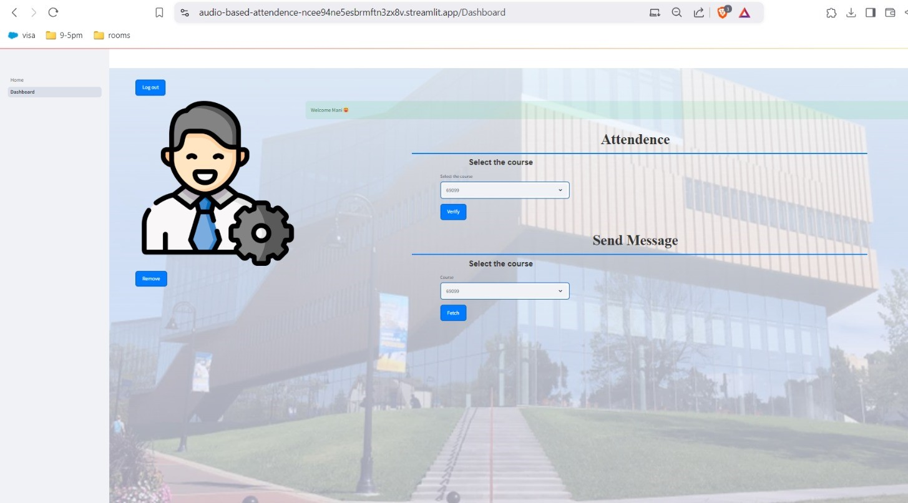
Currently We are Working on …….
Are You Ready to Explore Our Application?

Slide 30
Currently We are Working on …….
Are You Ready to Explore Our Application?

Slide 31
Why Voice-Based Verification?
Are You Ready to Explore Our Application?
Notes:
Get ready to experience the features and functionality of our attendance system in action!

Slide 32
Why Voice-Based Verification?
Are You Ready to Explore Our Application?
Enhanced Security
Single Login for Account
Accessibility
Notes:
Let’s take a closer look at why Voice-Based Verification stands out as a secure and user-friendly authentication method.
This technology isn’t just innovative—it’s practical, adaptable, and designed to address both modern security concerns and user needs. Here are the key advantages:
Enhanced Security
Unique Biometrics: Each voice is distinct, shaped by physiological and behavioral traits, making it a highly secure option.
Difficult to Forge: Advanced algorithms make it nearly impossible to replicate someone’s voice accurately, unlike passwords that can be guessed or stolen.
User Convenience
Hands-Free Authentication: No need to remember codes or type passwords—perfect for mobile and on-the-go scenarios.
Fast and Frictionless: Authentication takes just a few seconds, saving time without sacrificing security.
Accessibility
Inclusive for All Users: Voice-based systems are accessible to individuals with visual or motor impairments, fostering inclusivity.
Multilingual Support: The ability to support various languages makes it suitable for diverse user groups.
Reduced Dependency on Passwords
Combats Password Fatigue: No more juggling complex passwords.
Reduced Vulnerabilities: Eliminating the reliance on passwords minimizes risks like phishing or weak password use.
With these benefits, voice-based verification not only ensures security but also makes authentication seamless and accessible for everyone.

Slide 33
METHODOLOGY
Why Voice-Based Verification?
Any Questions
Enhanced Security
Single Login for Account
Accessibility
Notes:
Let’s take a closer look at why Voice-Based Verification stands out as a secure and user-friendly authentication method.
This technology isn’t just innovative—it’s practical, adaptable, and designed to address both modern security concerns and user needs. Here are the key advantages:
Enhanced Security
Unique Biometrics: Each voice is distinct, shaped by physiological and behavioral traits, making it a highly secure option.
Difficult to Forge: Advanced algorithms make it nearly impossible to replicate someone’s voice accurately, unlike passwords that can be guessed or stolen.
User Convenience
Hands-Free Authentication: No need to remember codes or type passwords—perfect for mobile and on-the-go scenarios.
Fast and Frictionless: Authentication takes just a few seconds, saving time without sacrificing security.
Accessibility
Inclusive for All Users: Voice-based systems are accessible to individuals with visual or motor impairments, fostering inclusivity.
Multilingual Support: The ability to support various languages makes it suitable for diverse user groups.
Reduced Dependency on Passwords
Combats Password Fatigue: No more juggling complex passwords.
Reduced Vulnerabilities: Eliminating the reliance on passwords minimizes risks like phishing or weak password use.
With these benefits, voice-based verification not only ensures security but also makes authentication seamless and accessible for everyone.

Slide 34
THANK
Why Voice-Based Verification?
Any Questions
YOU
Enhanced Security
Single Login for Account
Accessibility

Slide 35
THANK
YOU
Any Questions

